Slide 1
Exploring the 3Rs and Reciprocity in Animal Research
Registered Charity No.s 1156927 & SC048960

Slide 2
The 3 Rs
Has anyone heard of the 3Rs?
If so, do you know what they are?
Notes:
Replacement, Reduction and Refinement are the 3Rs (Don’t tell them yet!)

Slide 3
The 3 Rs
The principles of the 3Rs were developed over 60 years ago by William Russell and Rex Burch in 1959. They were to provide a framework for performing more humane animal research.
Can you guess what the 3 Rs are?
To give you a clue, there are 3 of them and they all begin with a R.
Replacement
Reduction
Refinement
Notes:
Replacement, Reduction and Refinement are the 3Rs

Slide 4
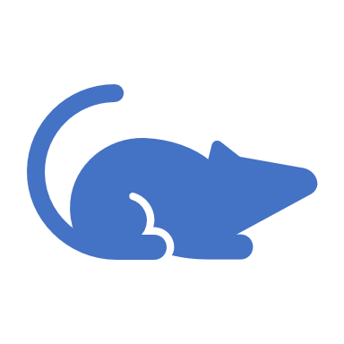
The 3Rs
Can you create a definition of each of the 3Rs?
Replacement – Avoiding or replacing animal use e.g. using cell cultures, computer modelling, or human tissue or volunteers.
Reduction - Where animal use is necessary, keeping numbers to the minimum e.g. using statistical methods to determine the smallest number of animals that can be used in an experiment.
Refinement - Where animal use is necessary, minimising pain and suffering and improving welfare e.g. using pain relief, provide housing that allows animals to perform their natural behaviours and handle them more sympathetically and appropriately.

Slide 5
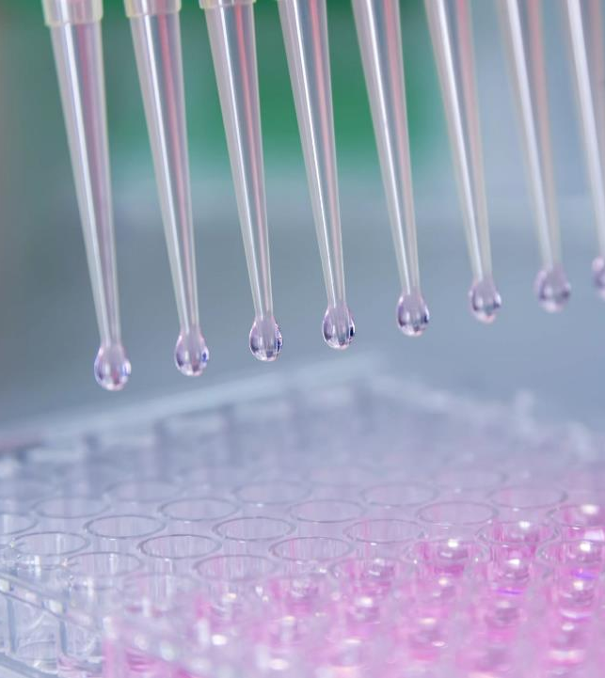
The 3Rs
Replacement – avoiding or replacing animal use.
e.g. using cell cultures, computer modelling, or human tissue or volunteers.
There are lots of new technologies available to replace animal use.
One fascinating alternative is - Organ-on-chips

Slide 6
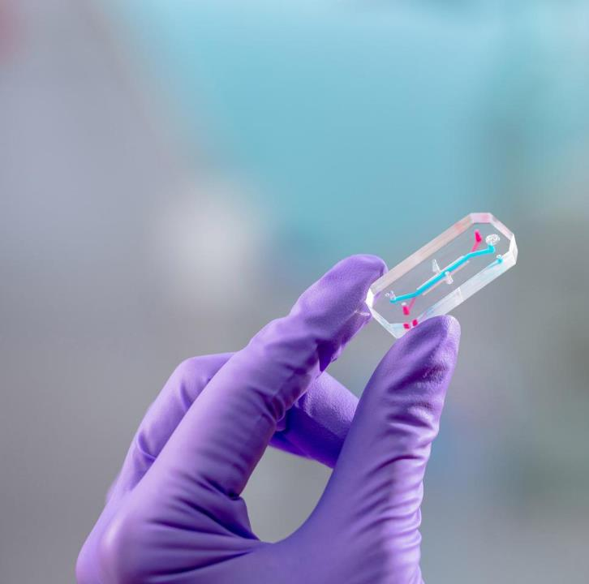
Replace
Photo courtesy of Emulate Inc.
Organs-on-Chips contain tiny hollow channels lined by living human cells that recreate the microenvironment experienced by cells within the human body.
As miniaturised living systems with human cells, Organs-on-Chips can predict human response with greater precision and detail than today's cell culture or animal-based testing, and can be used in a laboratory to test drugs and understand how the body works.
Notes:
In 2020, A new research centre which aims to revolutionise medical research and drug development using microengineered Organs-on-Chips has opened at Queen Mary University of London.

Slide 7
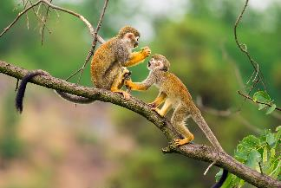
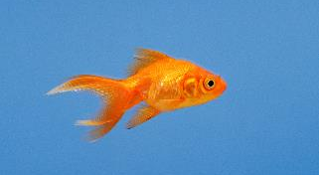
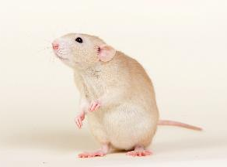
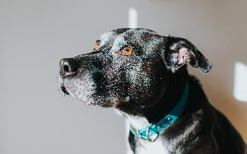
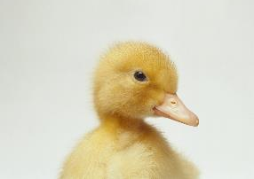
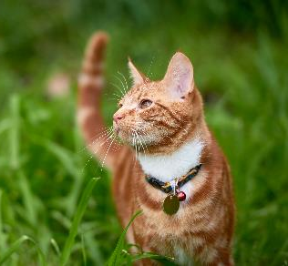
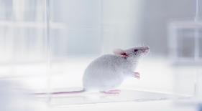
The 3Rs
Reduction – If it is scientifically necessary to use animals, to use the smallest number of animals possible.
Did you know?
Latest figures show an increase in animals used in research in 2021 in the UK for scientific, medical and veterinary research
Number of procedures on animals in 2021 has increased by 6% to 3.06 million
Mice, fish, rats, and birds account for over 96% of all procedures
Cats, dogs, and primates account for 0.2% of all procedures
Can you work out:
How many animals were used in experiments in 2021?
How many mice, fish, rats and birds accounted for the number used?
How many cats, dogs and primates account for the number of animals used in experiments?
Notes:
How many animals were used in animal experiments in total in 2020? Can you work out, how many mice, fish, rats and birds were used in 2021 in animal experiments Can you work out how many cats, dogs and primates were used in 2021 in animal experiments.

Slide 8
The 3Rs
Refine – Where animal use is necessary, minimising pain, distress, suffering or lasting harm and improving welfare
How do you think this could be achieved?
Spend ten minutes with a partner to decide how this can be achieved….
Carefully plan and design studies to minimise the above
Use pain relief and anaesthesia to minimise pain
Provide housing that allows animals to perform their natural behaviours
Handle them more sympathetically and appropriately
Train animals so that they can understand what is required to minimise their stress

Slide 9
Humanimal Trust DOES NOT fund any research which involves the use of experimental animal models
We are looking forward to the day when there is no more testing on animals.

Slide 10
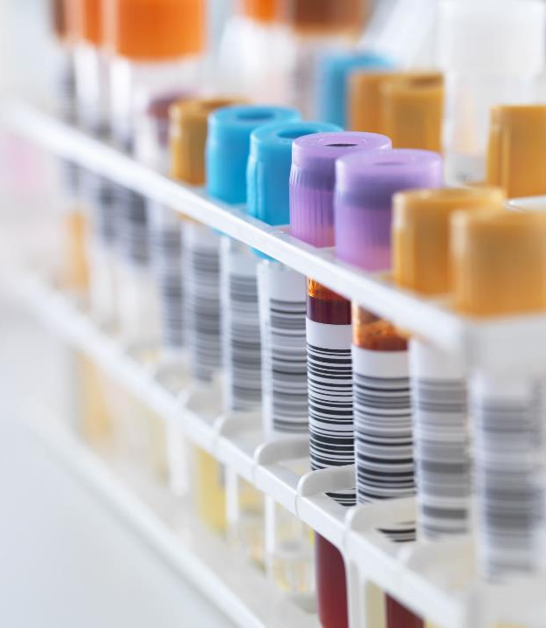
The 3Rs
Legislation:
Since 2009, the testing of cosmetics has been banned in the EU – but not throughout the world.
In 2010 the government in the UK have been committed to implementing the 3Rs
March 2023, The USA government’s newly passed FDA Modernisation Act, means that it is no longer mandatory to test drugs on animals prior to release for sale and use.
Sadly, in 2023, the UK government has legislated that animal testing should recommence

Slide 11
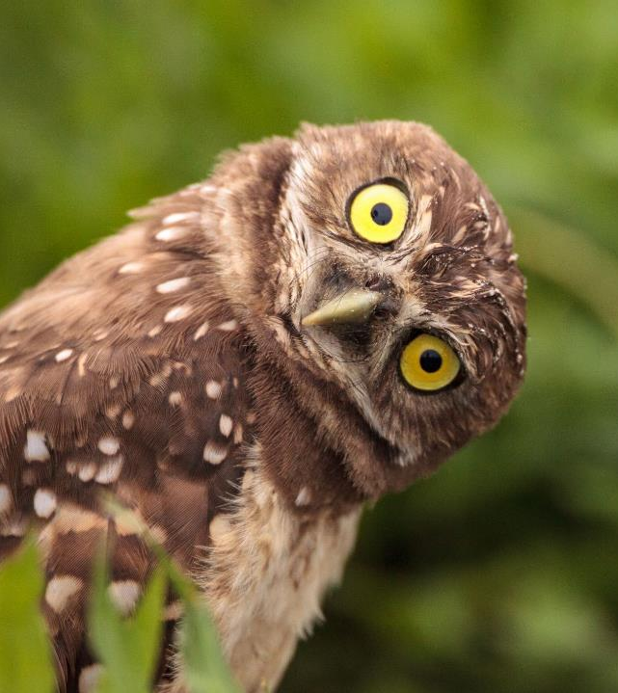
Instead of 3Rs….
How about, if instead of 3Rs, there were 4Rs?
At Humanimal Trust, we believe, while testing on animals is still being carried out, that we should include a fourth R.
Can you work out what that 4thR may be?
This R stands for reciprocity – have you heard that word before? Can you guess what it might mean?

Slide 12
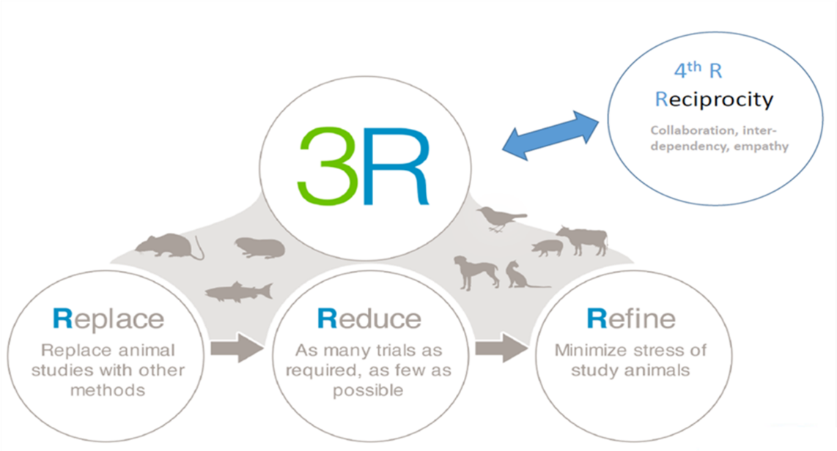
4Rs

Slide 13
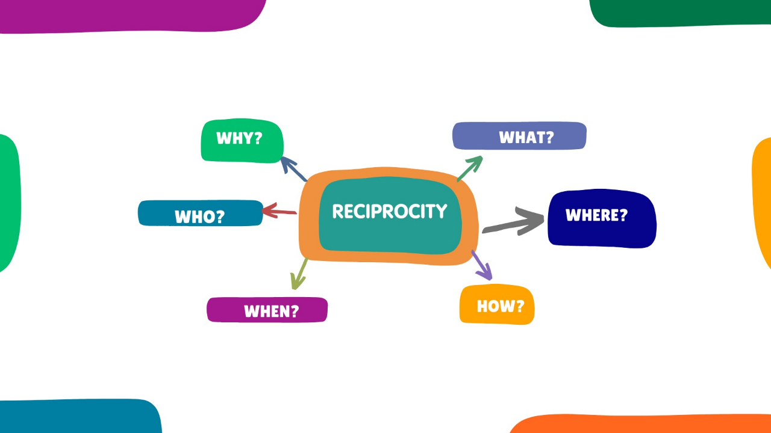

Slide 14
We need to do something - NOW
We will all pay the price in wasted time, money and lives of both humans and animals, without the 4thR, reciprocity.

Slide 15
How can you be part of the change?
You can be part of this movement – to create that 4th R, Reciprocity.
Write a persuasive speech to a group of researchers as to why they should include the 4th R, in their work
Notes:
Ask students to find how they can be part of the movement going forward

