Slide 1
The musculoskeletal system and joint replacement
Registered Charity No.s 1156927 & SC048960

Slide 2
Quiz
How many bones in a human body?
How many bones in a dog’s body?
How many cervical vertebrae do humans have? Dogs? Horses? Giraffes?
How many thoracic vertebrae do humans have?
What does a muscle do?
What kind of issues can people have with their joints?
What kind of issues can people have with their muscles?

Slide 3
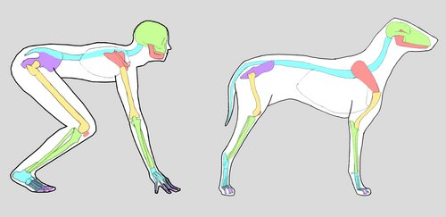
How similar are we?
Can you name any of the matched coloured bones?
Notes:
Green – skull
Peach – mandible
Light blue – spine
Peach – shoulder blade
Yellow forelimb – humerus
Green - radius and ulna
Light blue – meta carpals
Purple – phalanges
Purple – pelvic bones
Hind limbs – femur
Green – tibia and fibula
Light blue hind limbs – tarsus
Purple – metatarsus and phalanges

Slide 4
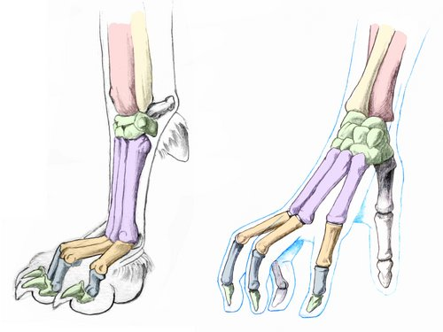
Human hand vs Dog paw
The bones are all the same
Notes:
pink – radius
Yellow - ulna
Green - carpus
Purple - metacarpuls
Orange – proximal phalanx
Grey – middle phalanx
Green – ungual process

Slide 5
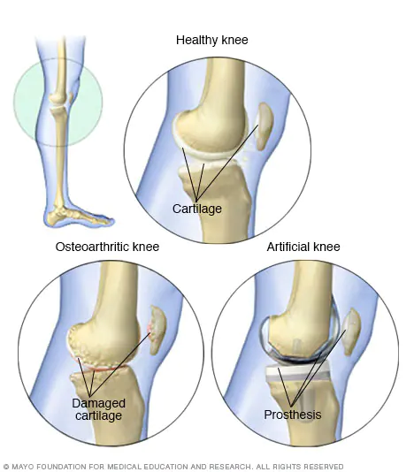
Knee replacements
Do you know anyone who has had a knee replacement?
Who was it?
How long was recovery?
Were there any healing issues?
Are they mobile again now?
Notes:
Knee replacement, also called knee arthroplasty or total knee replacement, is a surgical procedure to resurface a knee damaged by arthritis. Metal and plastic parts are used to cap the ends of the bones that form the knee joint, along with the kneecap. This surgery may be considered for someone who has severe arthritis or a severe knee injury. Recovery: You should be able to stop using your crutches or walking frame and resume normal leisure activities 6 weeks after surgery. However, it may take up to 3 months for pain and swelling to settle down. It can take up to a year for any leg swelling to disappear.

Slide 6
Musculoskeletal Disease
Musculoskeletal disease
Notes:
What could we learn from the operations in dogs that would help humans? (3 minute pair work)
Vice versa (3 minute pair work)
Put answers together and look for similarities/differences between humans and animals – This is why we need One Medicine

Slide 8
One Medicine
Most human studies cost around thirteen million pounds to conduct. We can decrease the cost and length of these studies if we work together, which is ONE Medicine.

Slide 9
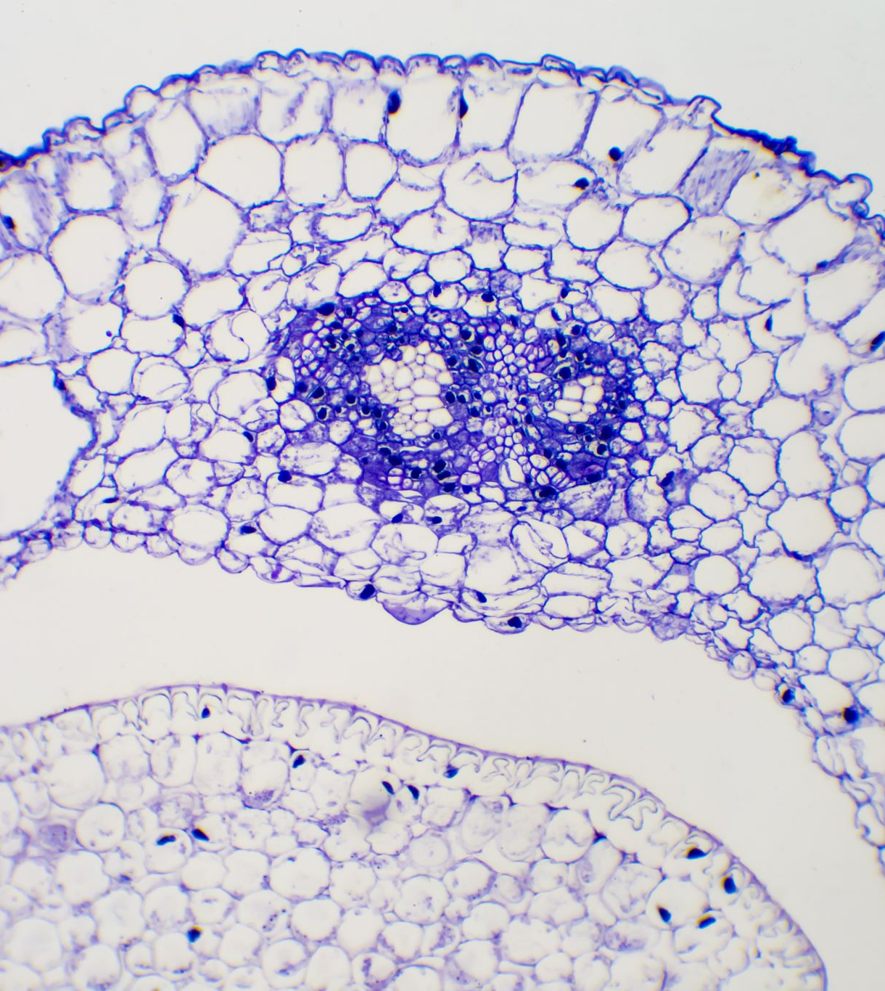
Musculoskeletal Disease
Plenary or homework:
Write a newspaper/article headline that relates to the key concept of this lesson.
The aim is to produce a headline that would make someone want to read your article.

